Slide 1

Role of ai in combatting climate change

Slide 2

What Is Climate Change?
What
Is
AI?

Slide 3
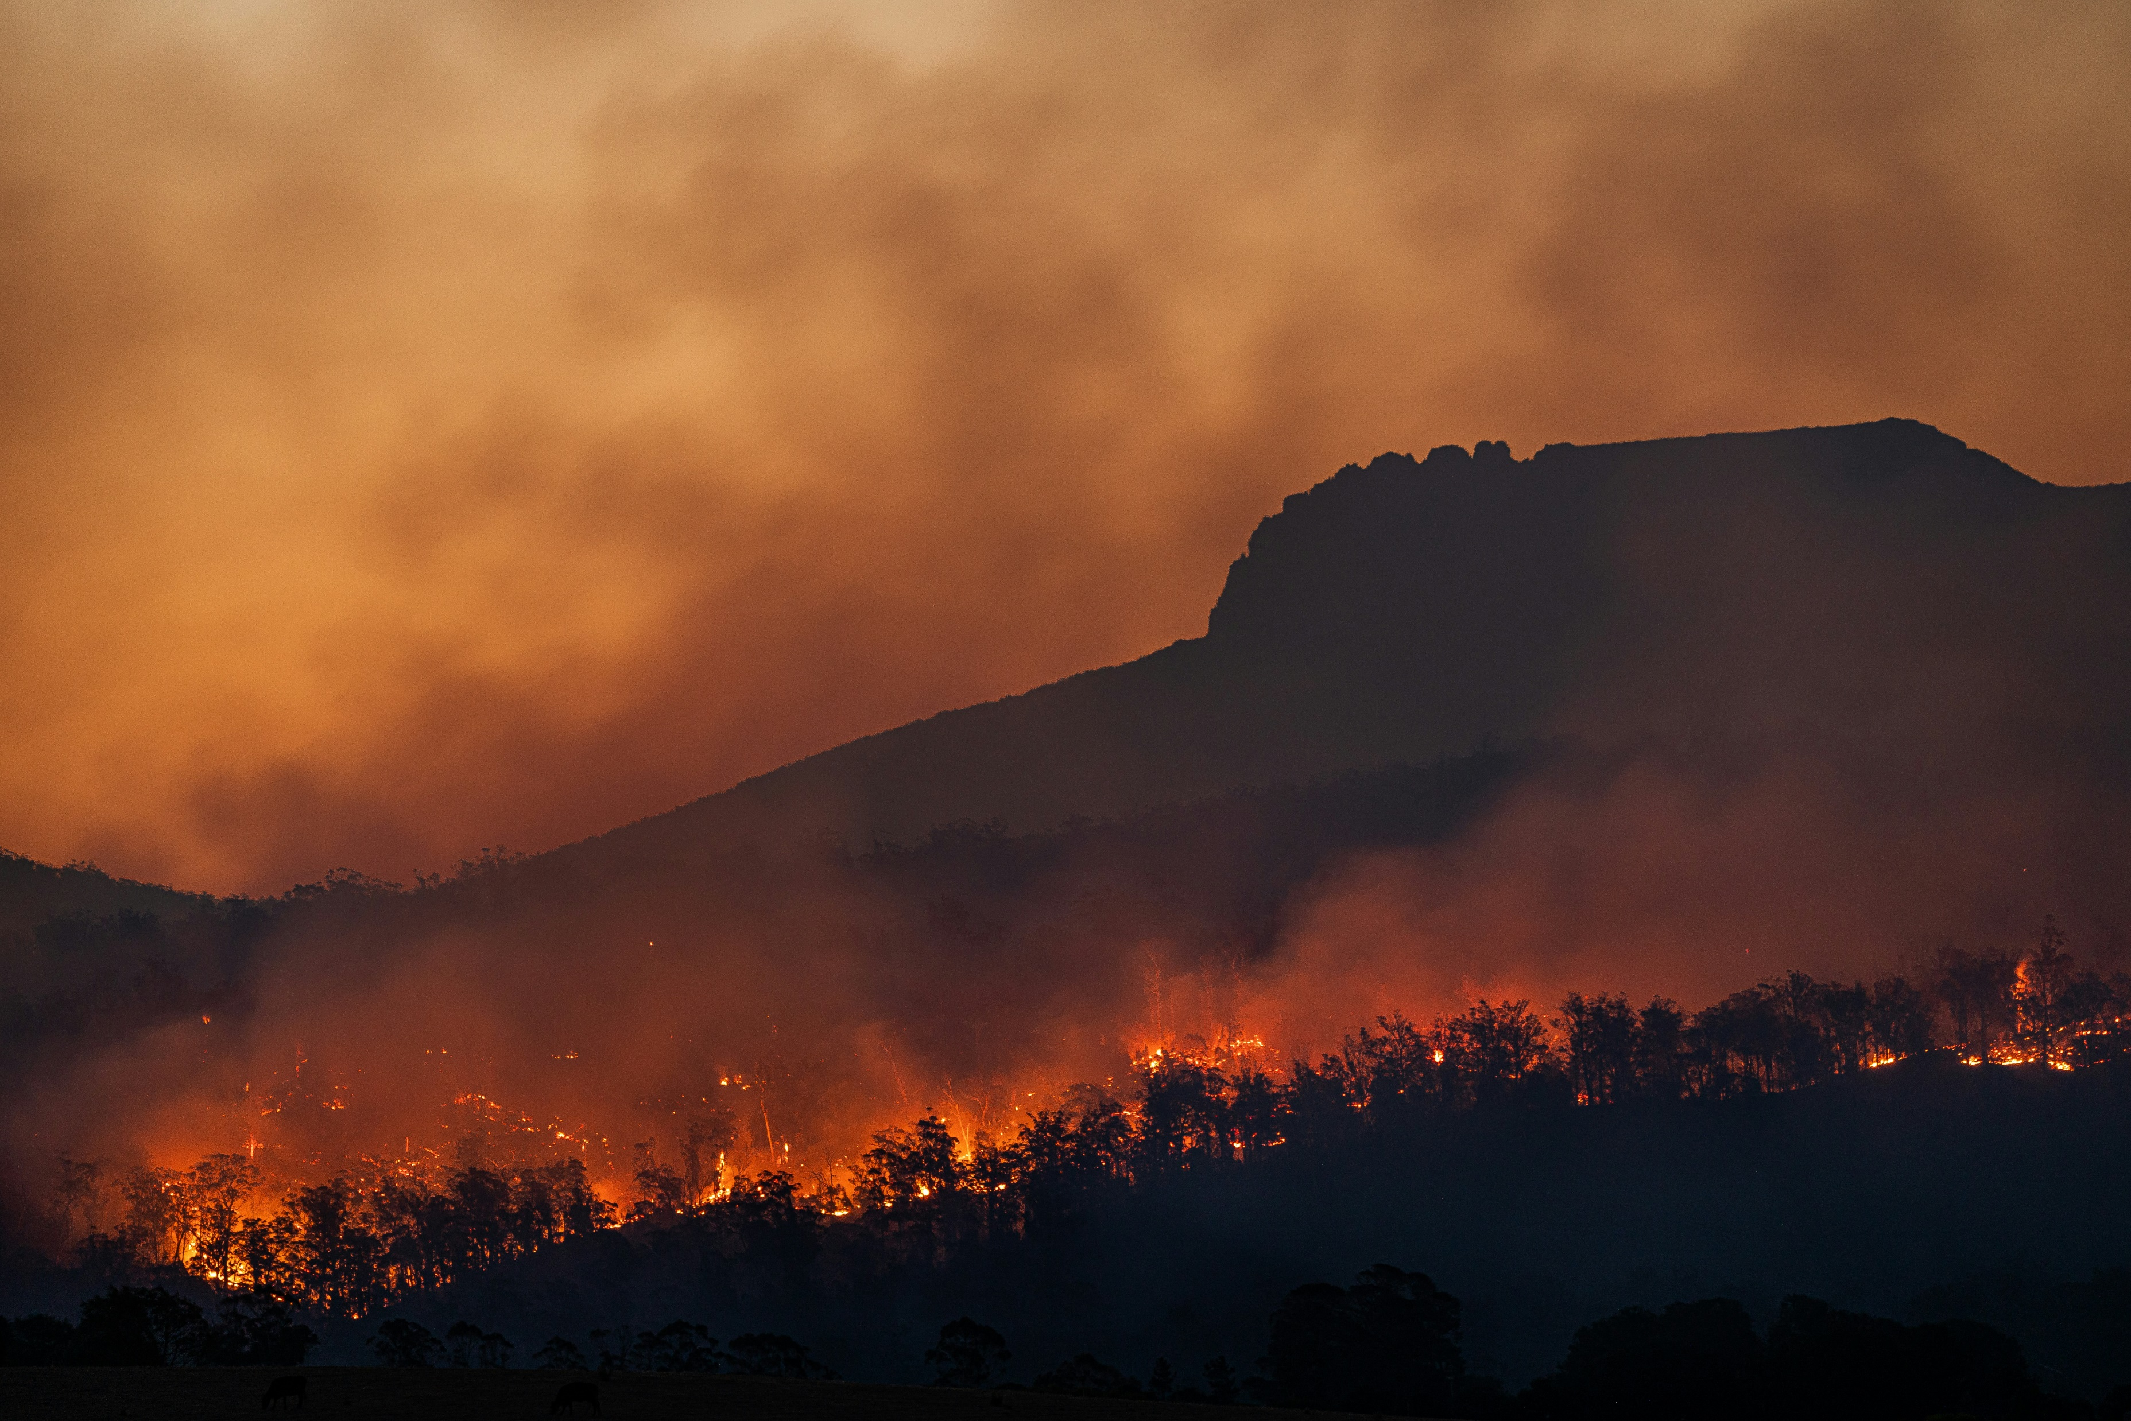
What Is Climate Change?
Climate change in 2024 and the years to come is only expected to get worse. For example, there is a 93% chance that one of the years between 2022 and 2026 will be the warmest year to date; breaking the previous record held by 2016
Canadian wildfires that spread smoke all the way to the U.S. and even across the pond to Paris. It is expected that 2024 will continue to be exceptionally warm, seeing as 2023 broke multiple temperature records worldwide.

Slide 4

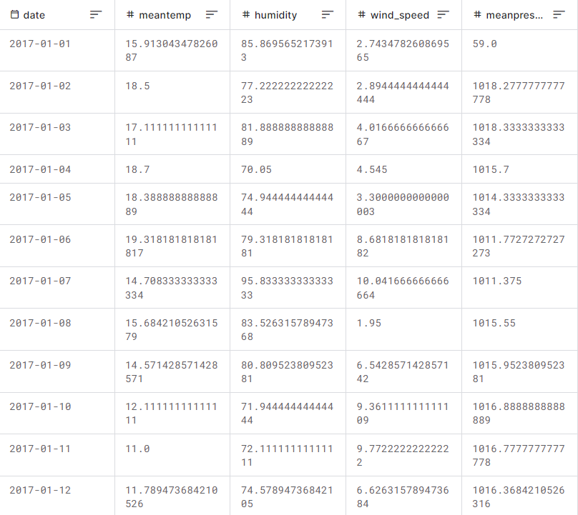
Data and dataset
Collection of examples
An essential part of Machine Learning
Data analysis

Slide 5

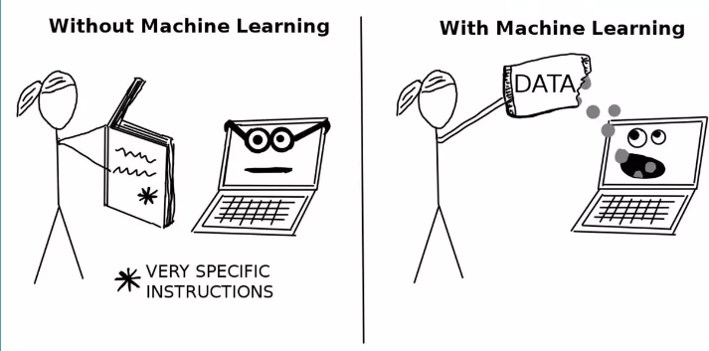
A program that trains the predictive model from input data
The system uses a learned model to make useful predictions from new data

Slide 6
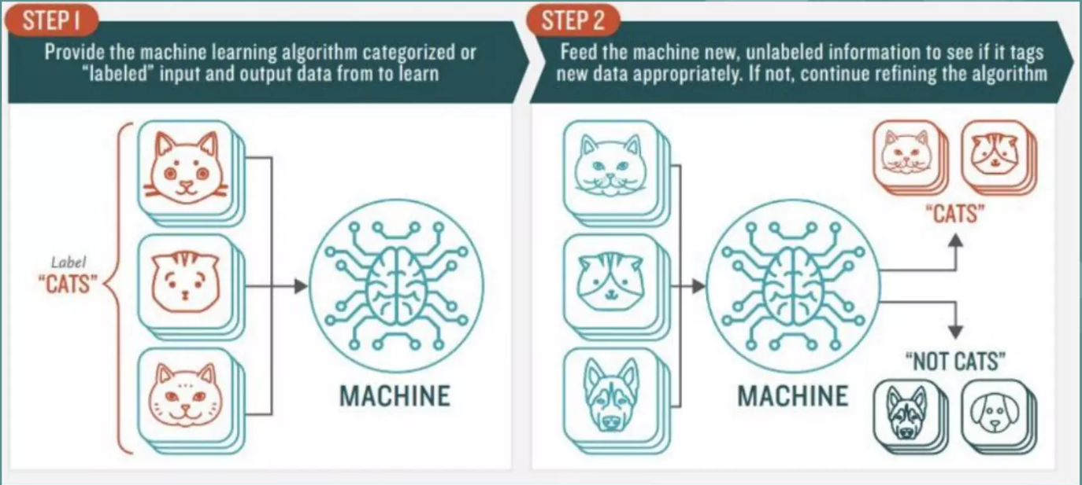

Slide 7
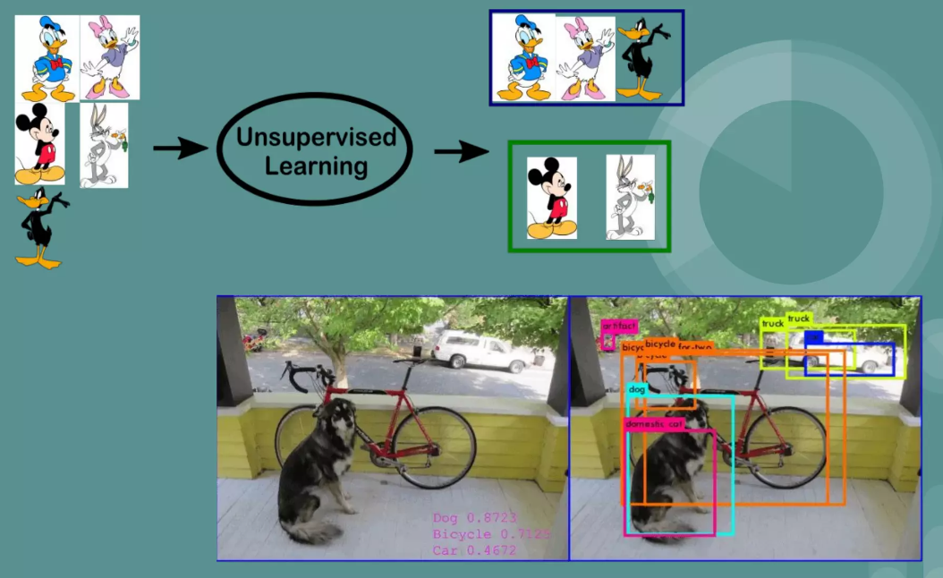

Slide 8

How can AI help combat climate change?
Understand our current reality
Predict future weather events
Impact making
Making business more efficient and sustainable

Slide 9
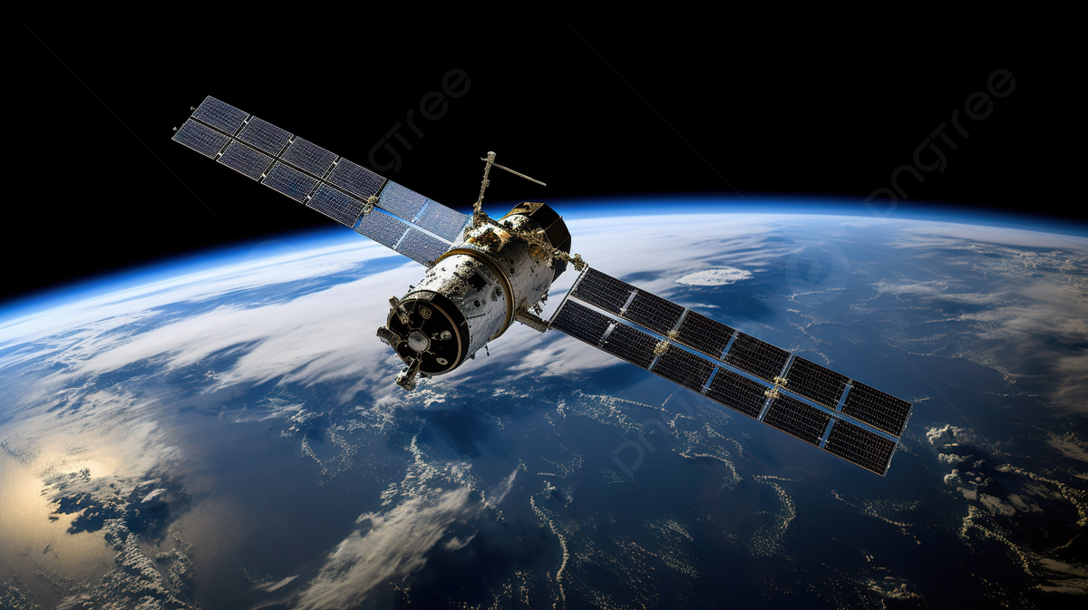
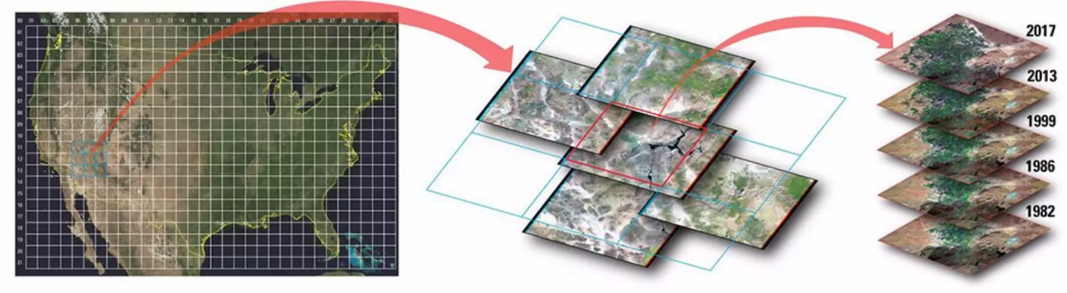
Climate Study:
Data from sensors, gauges, monitors
This info can be shared with decision-makers

Slide 10
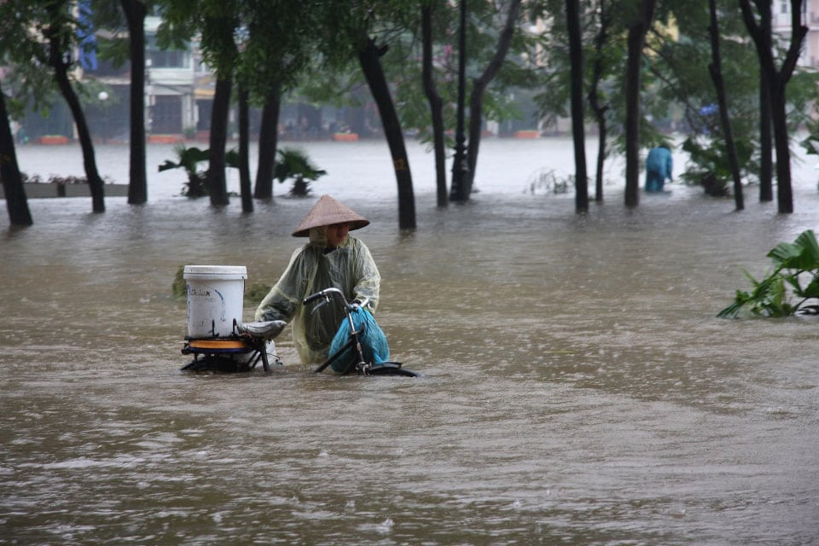
Better Weather Predictions
Earlier Warnings
Google Deepmind – Graphcast
ClimateAi

Slide 11
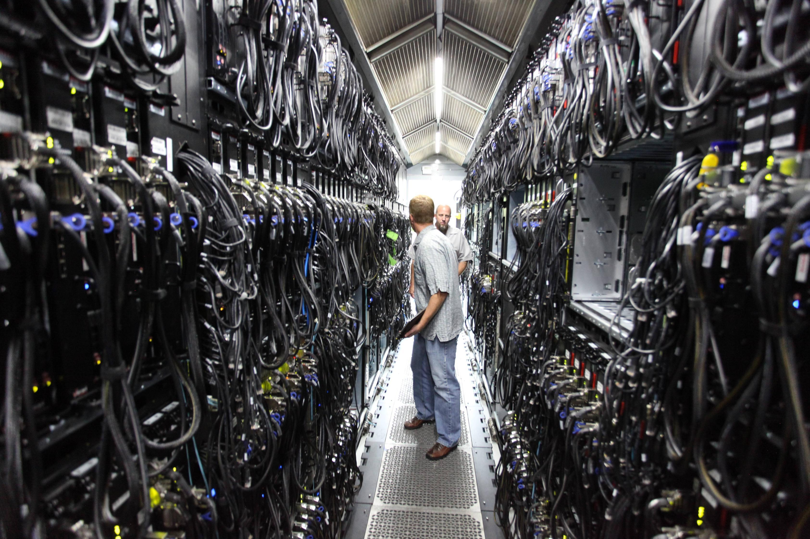
Better Weather Predictions
Earlier Warnings
Google Deepmind – Graphcast
ClimateAi
Developing Better Solutions
By using info provided by machine learning algorithms google was able to cut the amount of energy it used at its data centres by 15%. Similar insights can help other companies reduce their Carbon footprint

Slide 12
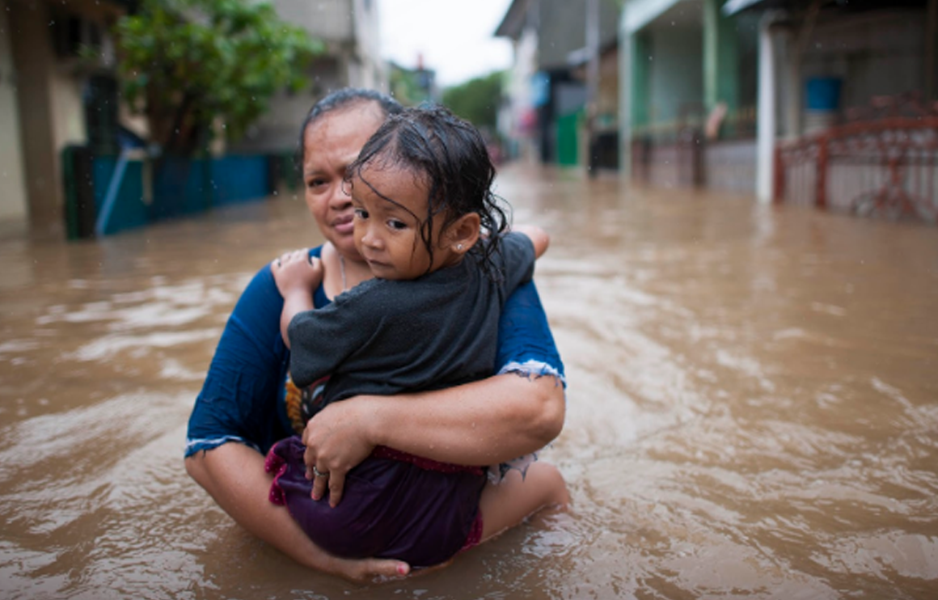
Effects of Extreme Weather
Monetary Institute for Learning Algorithms (MILA)
Microsoft, Conscient Labs used GANs → What homes are going to look after damage by sea

Slide 13
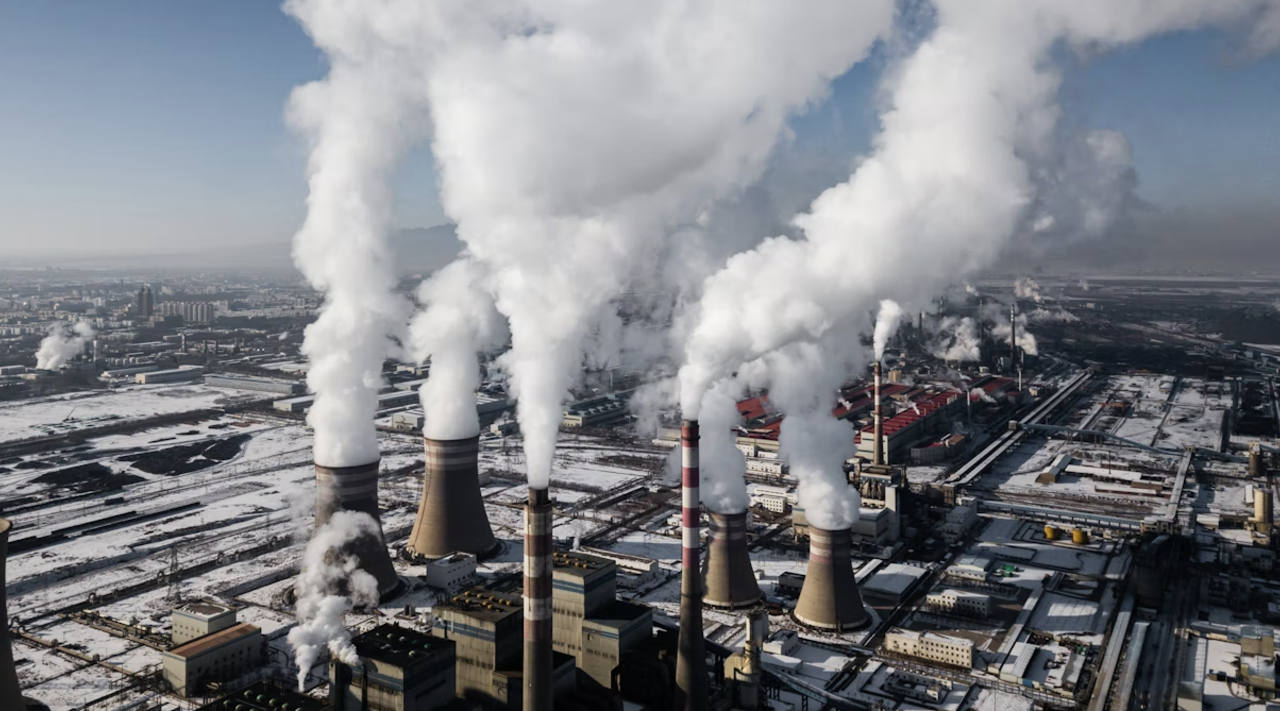
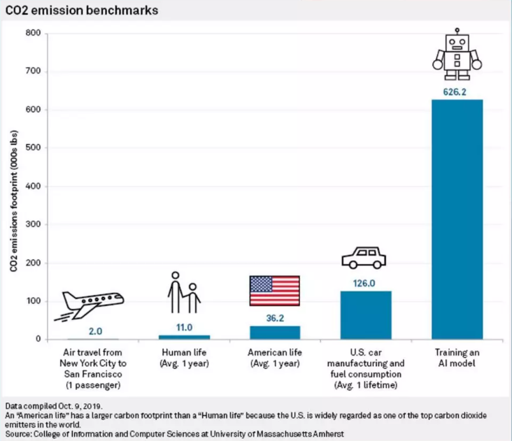
SIDE EFFECT

